Slide 1
Procter and Gamble Analysis project 1

Slide 2
Procter and Gamble
P&G was founded in Cincinnati, OH
P&G specialized in consumer goods, a leading household products in USA and has branches in nearly 80 countries around the world.
The company’s main products are home care, beauty care, baby care, laundry care, health care, snacks.
In 2018, P&G reported earnings $9.750 billion with annual revenue of $66.832 billions.
Its three main competitors are Colgate Palmolive, L’oreal, Kimberly Clark.
P&G is facing a commodity cost inflation. To balance the burden, the company raise prices at the shelf in certain products in some locations, but mainly disinfectant and cleaning products.
The area has been a big success is feminine care, especially adult incontinence products.
Looking from stock perspective, it’s a slow growth value stock.
As present, PG partner with European bottle Paboco to replace plastic usage with paper.

Slide 3
According to the Performance Chart (Growth of 10,000) Index of PG, it measures the performance consumer defensive industry in which PG belongs to this category, and it shows that the Toral return % line for this category is going upward which means the probability that the company growth and earnings in this kind of industry will increase.

Slide 4
PG Strengths and Weaknesses
P&G is having a difficulty in commodity cost inflation that bring some headaches to the managers. To balance of the cost burdens that spreading throughout the industry, the company raise prices at the shelf in certain products and in some locations like the competitors, but mainly on the products that consumers focus on in which cleaning and disinfectant products.
The area that has been a success is its feminine care, specifically is adult incontinence products, where it has maintained more than 25% value share and keep a steady growth in successive years. “Always” brand has increased 50% in the growth and contribute to an increased on firm’s household breakthrough market by 15 points.

Slide 5
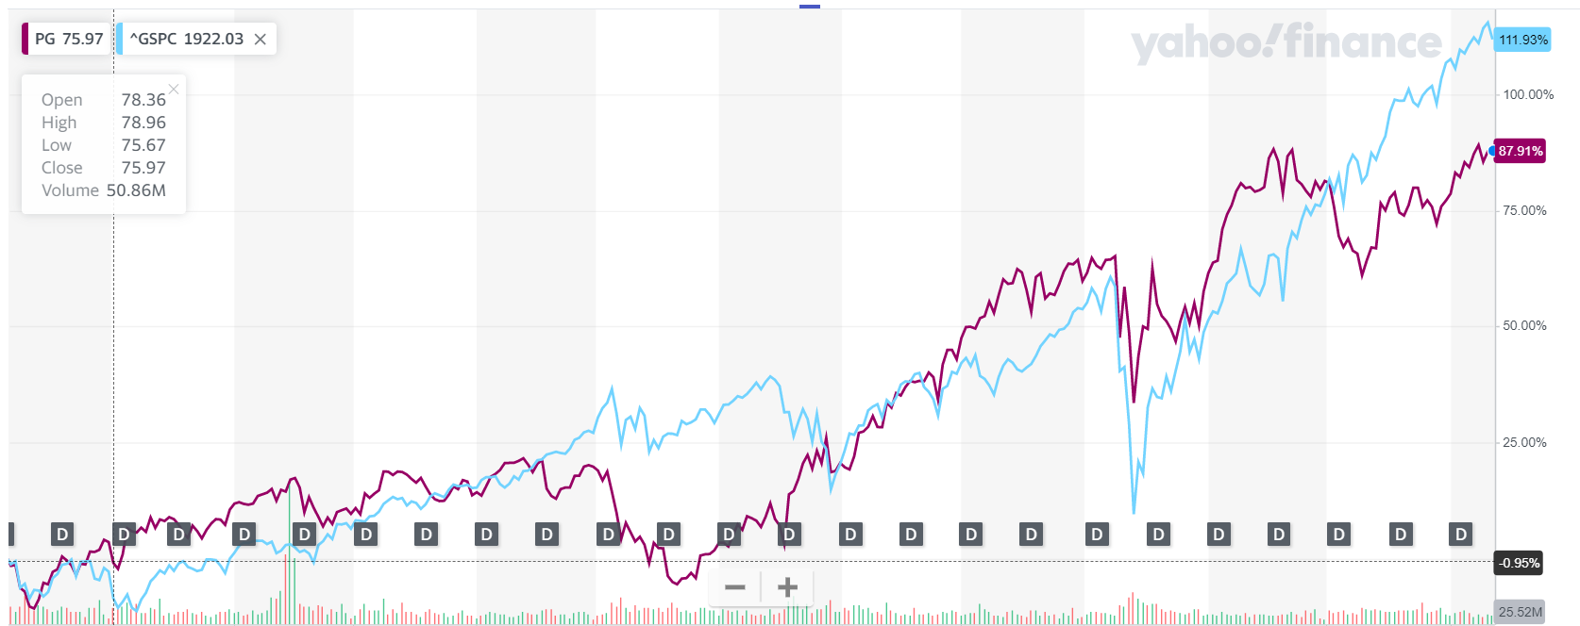
PG common stock in the markets
Choosing SP500 for comparing PG stocks because it consists of a broad market of stocks without too many small or obscure companies. The 500 comprises of 80% of overall value of stock market in the US. The purple lines indicate for P&G and the blue line is for SP500. Looking at the chart, the blue line has grown at a faster rate then PG because SP500 have high tech companies. PG is a slow growth value stock, whereas, high tech stock grows faster.

Slide 6
Procter and Gamble Analysis project 2

Slide 7
Financial Analysis PG vs competitors
Looking at variety of financial ratios, it shows that P&G is a well-established company and It’s doing well financially.
Short term ratio:
Quick ratio measures the ability of a company to use quick assets or cash to solve liabilities. Accounts receivable ratio is used to measure how good the company does in giving credit and collecting debts.
. Current ratio for both companies is not very good over the years, but P&G shows a lower current ratio compared to their competition. This is not good since this shows portraits how our company has a lower ability to meet short-term obligations.

Slide 8
Quick Ratio for PG
Quick ratio for P&G is not as good compared to its competition. Taking in mind that a normal quick ratio is around 1, both companies are struggling to get rid of their current liabilities.

Slide 9
Long term debt ratio
Long term debt results show the amount of assets a company would have to liquidate in order to pay its debt. The lower the numbers are better, P&G has great results given that its numbers are way lower than its competitors

Slide 10
Debt to Equity Ratio
Debt to equity ratio shows how much of shareholders equity and debt is used to finance assets. A good debt to equity ratio is considered to be below one, which is the case for P&G in the last three years. P&G shows, once again, better results than competitors when managing leverage, the company has way less volatility and is showing a healthier status.

Slide 11
Fixed asset turnover
Fixed asset turnover indicates how good is the company using its fixed assets to generate sales. Colgate has higher fixed assets ratio than P&G, this means that they are doing a better job at using their assets to generate revenues. This is not a good result for our company given that this means that Colgate is using their assets in their favor more than them.

Slide 12
Profit Margins
Profit margin ratio shows us how much of a company’s activities generate profit. Profit margin is higher in the last two years for P&G. This means that the company generated greater profit per sale than their competition. Profit margin for the industry is 0.084. This means that, compared to its industry, P&G is having more profit per sale.

Slide 13
Procter and Gamble Analysis project 3

Slide 14
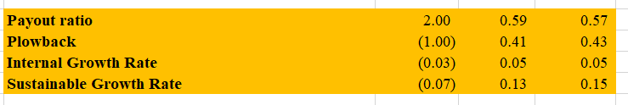
Financial Analysis
P&G has the highest internal growth rate achieved this year 2021 without needing external funding to help the business to operate at 5%
It also have high sustainable growth rate (15%) saying that it can maintain without having to finance growth with equity or additional debt. The number shows that PG has maximize the sales efforts with focusing on products with high profit margins and inventory management.
SGR = ROE *(1-Dividend payout ratio)
However, in order to maintain a high sustainable growth rate in the long term will be difficult due to various reasons, such as competition in the market, adapting to changes in economic condition such as Covid pandemic, and the need of increased research and development.

Slide 15
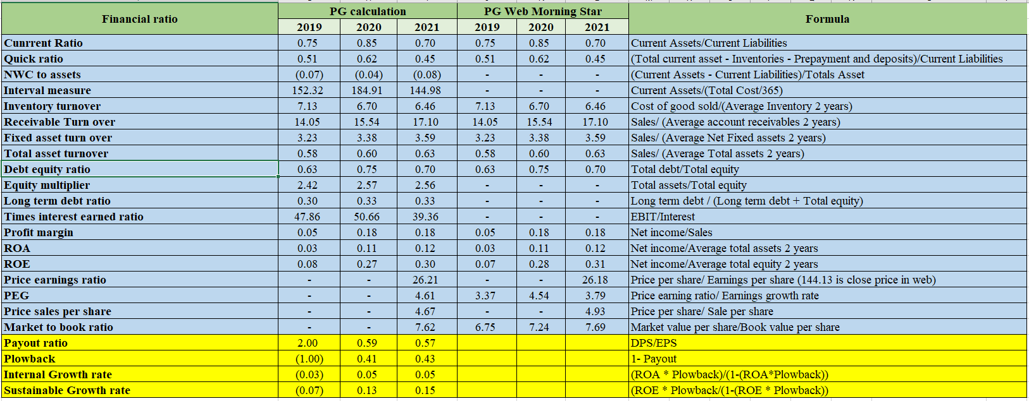

Slide 16
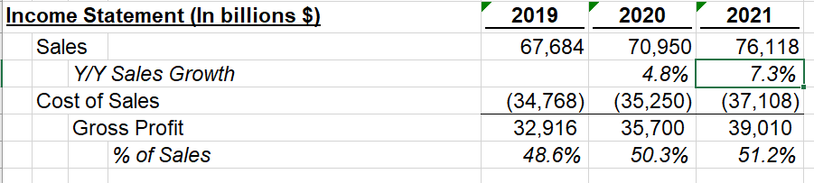
Financial Analysis
I take the assumption of the sale growth, cost of sales, SG&A, operating income so that I can compare the trend from the historical years to the current year 2021 and project it to the year of 2022.
Looking through the ProForma calculations, I've notice there is a big jump for sales from the year 2020 to 2021 (4.8%- 7.3%), the reason probably because of the pandemic that consumer start to stock up disinfecting and household products.
In balance sheet, the components look the same as previous years except for the cash, receivable inventory, payable, retained earnings that does not look consistent.

Slide 17
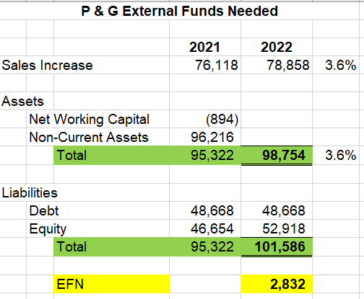
Financial Analysis
Evaluating the External Financial Need, Proctor & Gamble does not need EFN because its EFN is >0.
Since the company does not need the external financing help, therefore, it has some extra cash flow.
If cash flows are stable in the next 3-5 years, they might be considered increase the dividends.
If PG has excessive cash on hand, and they don’t have investment to utilize it, it should repurchase stocks.

Slide 18
Works Cited
“The Procter & Gamble Company 424(b)(5).” The Procter & Gamble Company, www.sec.gov/Archives/edgar/data/80424/000095015207008756/l28662be424b5.htm#108. Accessed 13 Sept. 2021.
“Yahoo Is Now a Part of Verizon Media.” Yahoo Finance, 10 Sept. 2021, finance.yahoo.com/quote/PG?p=PG.
“Procter & Gamble Brings Relief to Residents Affected by Hurricane Ida in Louisiana With P&G Products and Tide Loads of Hope Laundry Services.” Procter & Gamble News, 4 Sept. 2021, news.pg.com/news-releases/news-details/2021/Procter--Gamble-Brings-Relief-to-Residents-Affected-by-Hurricane-Ida-in-Louisiana-With-PG-Products-and-Tide-Loads-of-Hope-Laundry-Services/default.aspx.
“Procter & Gamble Announces First Lenor Paper Bottle Pilot and Joins Paboco Community of Pioneer Brands.” Procter & Gamble News, 20 July 2021, news.pg.com/news-releases/news-details/2021/Procter--Gamble-Announces-First-Lenor-Paper-Bottle-Pilot-and-Joins-Paboco-Community-of-Pioneer-Brands/default.aspx.
“Febreze Reinvents Fabric Freshness with New Febreze Touch Technology.” Procter & Gamble News, 19 Aug. 2021, news.pg.com/news-releases/news-details/2021/Febreze-Reinvents-Fabric-Freshness-with-New-Febreze-Touch-Technology/default.aspx.
“https://s1.q4cdn.com/695946674/files/doc_downloads/2021/08/PG_2021_Annual_Report.pdf”, pages 9,96,97

Slide 19
Harvey, Amy. “Who Are Procter & Gamble’s Main Competitors? (PG, REV).” The Entrepreneur Fund, 15 Jan. 2019, theentrepreneurfund.com/who-are-procter-gambles-main-competitors-pg-rev.
---. “Who Are Procter & Gamble’s Main Competitors? (PG, REV).” The Entrepreneur Fund, 15 Jan. 2019, theentrepreneurfund.com/who-are-procter-gambles-main-competitors-pg-rev.
Procter & Gamble. “Leadership.” Procter & Gamble, 23 Mar. 2020, us.pg.com/leadership-team.
“---.” Procter & Gamble, 21 Aug. 2021, en.wikipedia.org/wiki/Procter_%26_Gamble.
“The Procter & Gamble Company - Company Profile, Information, Business Description, History, Background Information on The Procter & Gamble Company.” Reference for Business, www.referenceforbusiness.com/history2/83/The-Procter-Gamble-Company.html. Accessed 13 Sept. 2021.

Slide 20
“How Internal Growth Rate Is Achievable for Business.” Investopedia, 11 Jan. 2021, www.investopedia.com/terms/i/internalgrowthrate.asp.
“---.” Investopedia, 11 Jan. 2021, www.investopedia.com/terms/i/internalgrowthrate.asp.
Reddigari, Manasa. “How to Calculate Sales Growth.” How to Calculate Sale Growth, 30 July 2019, mileiq.com/blog-en-us/how-to-calculate-sales-growth.

